Slide 1
LogiMAT India
2025
International Trade Fair for Intralogistics
Solutions, Transportation & Process Management

Slide 2
LogiMAT India 2024:
Facts, Figures and Data

Slide 3
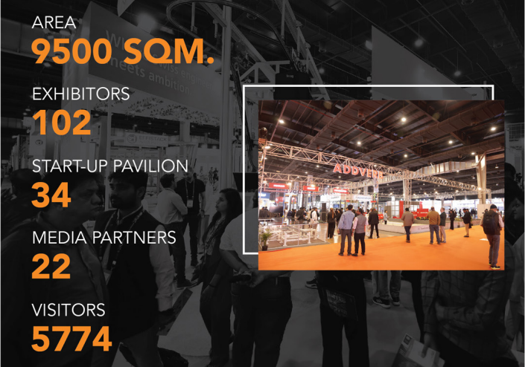
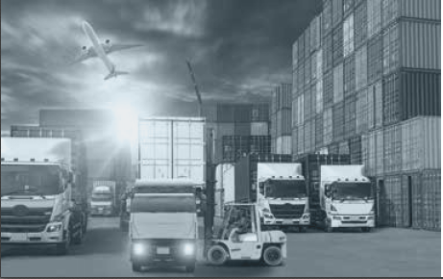
LogiMAT India 2024 in Numbers
102
CONFERENCE
Speakers: 51
Conference Sessions: 15
Conference Delegates: 150
9.500 sqm

Slide 4
LogiMAT India 2025:

Slide 5
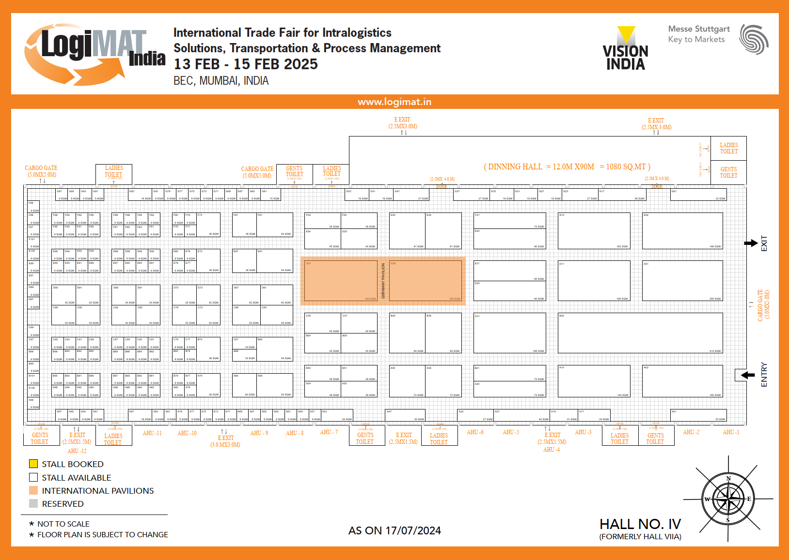

Slide 6
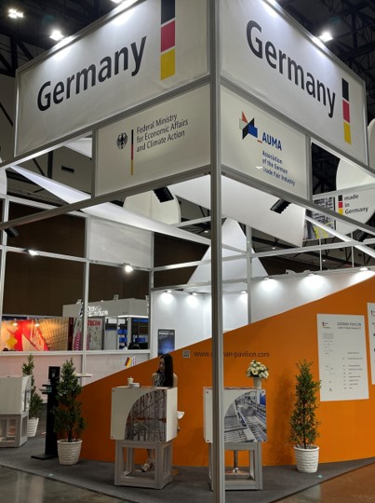
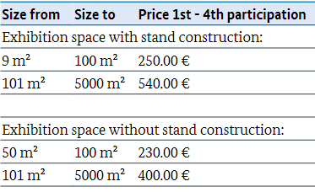

German Pavilion
Your benefits:
Easy participation and financial support from the federal government
Attractive stand design and stand location
Professional support in organizing the show logistics
Common infrastructure: information booth with catering, internet connection, office services and lounge area
Participation Prices:
Registration deadline is November 20, 2024.

Slide 7

Associations and Government Support:
VDMA Materials Handling and Intralogistics Association
VDMA India Services Private Limited German Engineering Federation (VDMA)
Invest India
GatiShakti Vishwavidyalaya
All India Association of Industries (AIAI)
Indian Chamber of International Business (ICIB)
Association of Multimodal Transport Operators of India (AMTOI)
Federation of Freight Forwarders Association of India (FFFAI)
All India Warehousing Welfare Association (AIWWA)
Deccan Chamber of Commerce, Industries, and Agriculture (DCCIA)
The Indian National Shipowners' Association (INSA)
Container Shipping Lines Association (CSLA)
Maritime Association Of Nationwide Shipping Agencies (MANSA)
National Association Of Container Freight Stations (NACFS)
Hydraulic Trailer Owners Association (HTOA)
Warehouse Association of India (WAI)
Association of Supply Chain Professionals (ASCP)

Slide 8
Thank you for your attention!
Contact for further information:
India
Mr. Ashutosh Kataria
Project Manager
ashutosh.kataria@messe-stuttgart.in
Germany
Ms. Julia Weiß
Project Manager
julia.weiss@messe-stuttgart.de

